Slide 1
EMERGING SYSTEMS FOR LARGE-SCALE MACHINE LEARNING
Joseph E. Gonzalez
Postdoc, UC Berkeley AMPLab
Co-founder, GraphLab Inc.
Ph.D. 2012, CMU
jegonzal@eecs.berkeley.edu
Slides (draft):
http://tinyurl.com/icml14-sysml
ICML’14 Tutorial

Slide 2
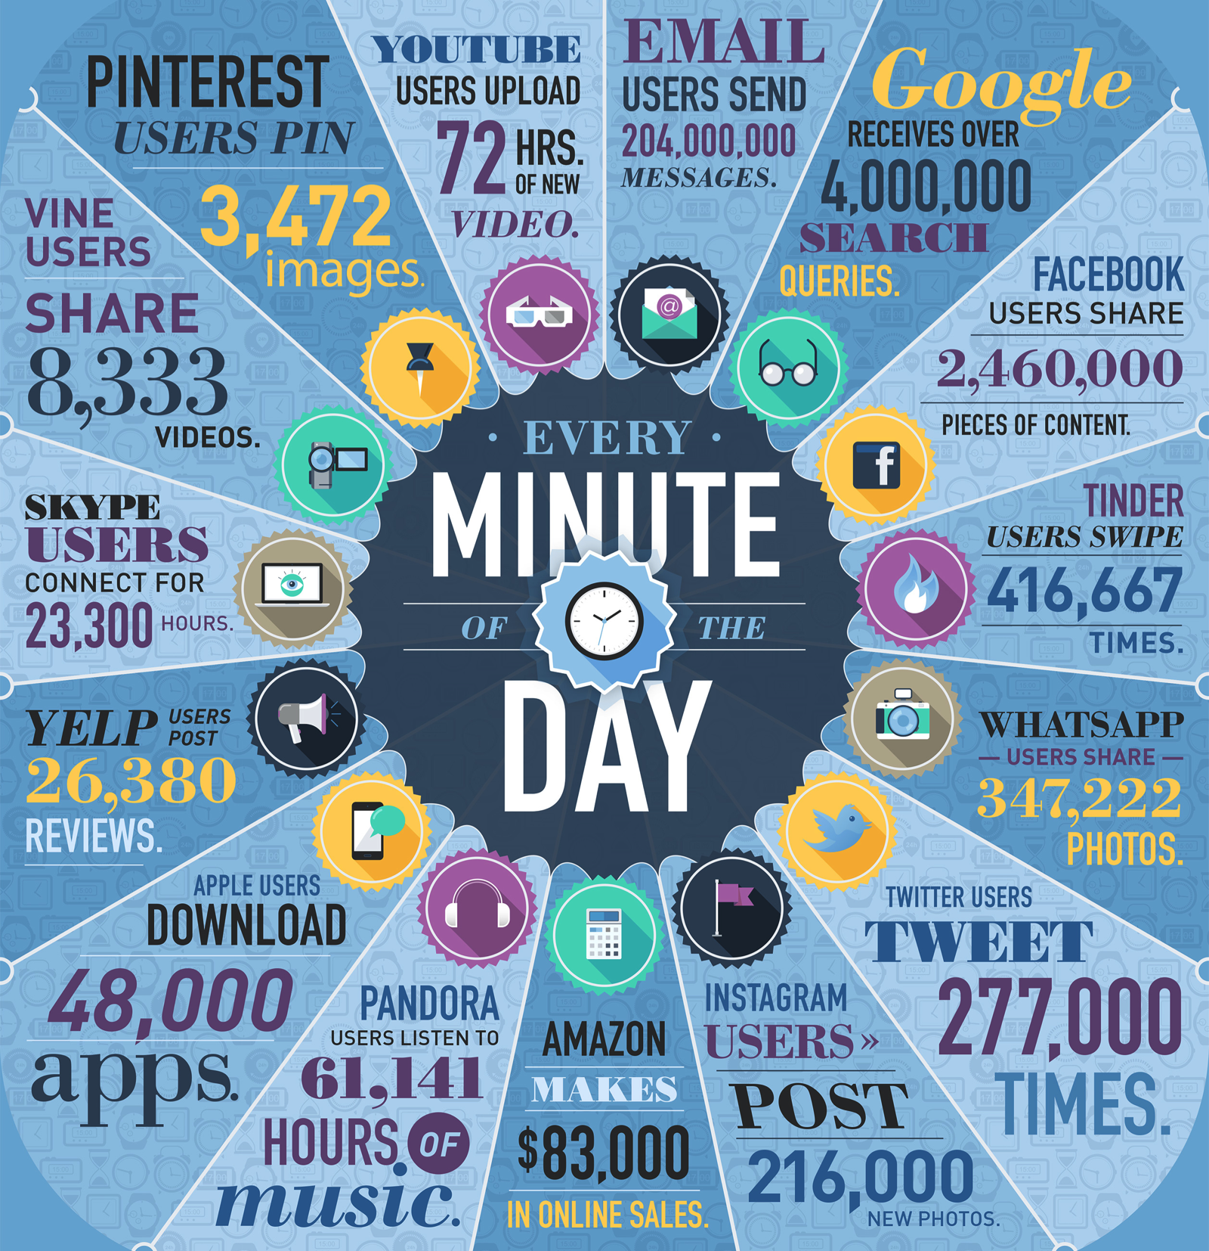
http://www.domo.com/learn/data-never-sleeps-2

Slide 3
http://www.domo.com/learn/data-never-sleeps-2

Slide 4
http://www.domo.com/learn/data-never-sleeps-2

Slide 5
http://www.domo.com/learn/data-never-sleeps-2

Slide 6
My story …
Machine Learning
Learning
Systems

Slide 7

As a young graduate student

Slide 8
As a young graduate student I worked on parallel algorithms for inference in graphical models:
Belief
Propagation
Gibbs Sampling
I designed and implemented parallel learning algorithms on top of low level primitives …

Slide 9
ML
Paper
Application
Idea
Model +
Algorithm
Evaluate
Debug
Optimize
Distributed
Prototype
Serial
Prototype
Optimize
Parallel
Prototype
Evaluate
ML
Paper
Debug

Slide 10
Advantages of the Low-Level Approach
Extract maximum performance from hardware
Enable exploration of more complex algorithms
Fine grained locking
Atomic data-structures
Distributed coordination protocols
My implementation is better than your implementation.

Slide 11
Limitations of the Low-Level Approach
Repeatedly address the same system challenges
Algorithm conflates learning and system logic
Difficult to debug and extend
Typically does not address issues at scale: hardware failure, stragglers, …
Months of tuning and engineering for one problem.

Slide 12
Design Complexity
Parallelism
Model
Network
Locality
Large-Scale
Systems
Machine Learning
Stragglers
Scheduling
Training
Accuracy
Fault Tolerance

Slide 13
Design Complexity
Parallelism
Model
Network
Locality
Interaction
Large-Scale
Systems
Machine Learning
Stragglers
Scheduling
Training
Accuracy
Fault Tolerance

Slide 14
Design Complexity
Parallelism
Model
Network
Locality
Interaction
Large-Scale
Systems
Machine Learning
Stragglers
Scheduling
Training
Accuracy
Fault Tolerance
Learning systems combine the complexities of machine learning with system design

Slide 15
Interesting Machine Learning
Research
ML
Paper
Application
Idea
Model +
Algorithm
Evaluate
Interesting Systems Research
Debug
Optimize
Abstraction
Distributed
Prototype
Serial
Prototype
Optimize
Parallel
Prototype
Evaluate
ML
Paper
Debug

Slide 16
Learning
Systems
Black
Box

Slide 17
Learning Algorithm
Common Patterns
Black
Box
Abstraction (API)
System
Parallelism
Data Locality
Network
Scheduling
Fault-tolerance
Stragglers

Slide 18
Managing Complexity Through Abstraction
Learning Algorithm
Common Patterns
Identify common patterns
Define a narrow
interface
Abstraction (API)
System
Exploit limited abstraction
to address system
design challenges
Parallelism
Data Locality
Network
Scheduling
Fault Tolerance
Stragglers

Slide 19

Junction
Tree Inf.
CoEM
ALS Matrix Fact.
Graph Parallel
Abstraction
Common
Pattern
Belief
Propagation
Gibb
Sampling
The GraphLab project allowed us to:
Separate algorithm and system design
Optimize system for many applications at once
Accelerate research in large-scale ML

Slide 20
Outline of the Tutorial
Distributed Aggregation: Map-Reduce
Iterative Machine Learning: Spark
Large Shared Models: Parameter Server
Graphical Computation: GraphLab to GraphX
Data Parallel
Model Parallel
Graph Parallel

Slide 21
What is not covered
Linear Algebra Patterns: BLAS/ScaLAPACK
core of high-performance computing
communication avoiding & randomized algorithms
Joel Tropp Tutorial (right now)
GPU Accelerated Systems
converging to BLAS patterns
Probabilistic Programming
See tutorial 5

Slide 22


Elephant in the Room
Map-Reduce

Slide 23
Aggregation Queries
Common Pattern
Abstraction: Map, Reduce
System

Slide 24
Learning from Aggregation Statistics
Learning Algorithm
Query:
System
Data
D. Caragea et al., A Framework for Learning from Distributed Data Using Sufficient Statistics and Its Application to Learning Decision Trees. Int. J. Hybrid Intell. Syst. 2004
Chu et al., Map-Reduce for Machine Learning on Multicore. NIPS’06.
Notes:
Chu and several others (including me) have incorrectly attributed this pattern to the statistical query model of M. Kearns, STOC’93.

Slide 25
Learning from Aggregation Statistics
Query Function:
System Executes:
on data

Slide 26
Example Statistics
Sufficient Statistics (e.g., E[X], E[X²]):
Empirical loss:
Gradient of the loss:

Slide 27
Map-Reduce Abstraction
[Dean & Ghemawat, OSDI’04]
Key
Value
Key
Value
Map
Reduce
Record
Key
Value
Key
Value
Value
Example: Word-Count
Map(docRecord) {
for (word in docRecord) {
emit (word, 1)
}
}
Reduce(word, counts) {
emit (word, SUM(counts))
}
Key
Value
Map: Idempotent
Reduce: Commutative and Associative

Slide 28
Map-Reduce System
Mapper 1
[Dean & Ghemawat, OSDI’04]
Record
2
1
1
Record
2
Reducer 1
Output₁
Mapper 2
1
1
Data
Record
Data₁
1
2
3
1
2
1
Record
Data₂
1
1
Record
Mapper 3
Data₃
1
1
2
Record
2
Reducer 2
Output₂
1
1
2
3
Record
3
1
1
1
Record
1
2
2
1
Record

Slide 29
Map-Reduce System
Mapper 1
[Dean & Ghemawat, OSDI’04]
Idempotent
Map Stage
(+Combiner Pre-agg.)
Shuffle
Stage
Commutative
Associative
Reduce Stage
Record
2
Record
2
Reducer 1
Output₁
Mapper 2
1
1
Record
1
1
3
2
Record
1
1
Record
Mapper 3
2
Record
2
Reducer 2
Output₂
1
Record
1
1
1
3
3
Record
2
2
Record

Slide 30
Map-Reduce Fault-Recovery
Mapper 1
[Dean & Ghemawat, OSDI’04]
Record
2
Record
2
Reducer 1
Output₁
Mapper 2
1
1
Record
1
1
3
2
Record
1
1
Record
Mapper 3
2
Record
2
Reducer 2
Output₂
1
Record
1
1
1
3
3
Record
2
2
Record

Slide 31
Map-Reduce Fault-Recovery
Mapper 1
[Dean & Ghemawat, OSDI’04]
Record
2
Record
2
Reducer 1
Output₁
Mapper 2
1
1
Record
1
1
3
2
Record
1
1
Record
Mapper 3
1
1
2
Record
2
Reducer 2
Output₂
1
1
2
3
Record
3
1
1
1
Record
2
2
Record

Slide 32
Distributed File Systems
[Ghemawat et al., SOSP’03]
A
A
Big File
A
B
B
B
C
C
D
C
D
D
Worker 1
Worker 2
Worker 3
Worker 4
D
C
C
B
A
C
B
A
B
A
D
D

Slide 33
Distributed File Systems
[Ghemawat et al., SOSP’03]
A
B
C
D
Worker 1
Worker 2
Worker 3
Worker 4
D
C
C
B
A
C
B
A
B
A
D
D

Slide 34
Important Systems Theme
What functionality can we remove?
Learning algorithm cannot directly access data.
Restrict computation to:
System controls interaction with data:
Distribute computation and data access
Fault tolerance & straggler mitigation

Slide 35
Least Squares Regression
Example:

Slide 36
Least-Squares Regression with Aggregation Statistics
Objective:
Solution (Normal Equations):
Big
Small

Slide 37
Deriving the Aggregation Stats.
Aggregation Statistics:
#mappers
Map( (x,y) record ) {
emit ( “xx”, x * Trans(x) )
emit ( “xy”, x * y )
}
Reduce(key, mats) {
emit (key, SUM(mats))
}

Slide 38
Deriving the Aggregation Stats.
Aggregation Statistics:
Solve linear system on the master:
#mappers
-1
=
Inversion doesn’t depend on n
d
d
d
d
1
1

Slide 39
Apache Mahout
Open-Source Library of Algorithms on Hadoop
ALS Matrix Fact.
SVD
Random Forests
LDA
K-Means
Naïve Bayes
PCA
Spectral Clustering
Canopy Clustering
Logistic Regression?

Slide 40
Limitations?
Map-Reduce

Slide 41
Logistic Regression?
Why not

Slide 42
Logistic Regression
Iterative batch gradient descent.
random initial line
+
+
+
+
+
–
+
–
+
+
–
–
+
+
–
–
–
–
–
–
target
Slide provided by M. Zaharia
Notes:
Note that dataset is reused on each gradient computation

Slide 43
Logistic Regression in Map-Reduce
Gradient descent:
Learning Algorithm
Query:
System
Data
Update Model:

Slide 44
Logistic Regression in Map-Reduce
Map-Reduce is not optimized for iteration and multi-stage
computation
Gradient descent:
Learning Algorithm
Query:
System
Data
Update Model:

Slide 45
Iteration in Map-Reduce
Initial
Model
Learned
Model
Map
Reduce
w⁽⁰⁾
w⁽¹⁾
Training
Data
w⁽²⁾
w⁽³⁾

Slide 46
Cost of Iteration in Map-Reduce
Initial
Model
Learned
Model
Map
Reduce
w⁽⁰⁾
w⁽¹⁾
Read 1
Training
Data
Repeatedly load same data
Read 2
w⁽²⁾
Read 3
w⁽³⁾

Slide 47
Cost of Iteration in Map-Reduce
Initial
Model
Learned
Model
Map
Reduce
w⁽⁰⁾
w⁽¹⁾
Training
Data
Redundantly save output between stages
w⁽²⁾
w⁽³⁾

Slide 48

Iteration and Multi-stage computation
In-Memory
Dataflow
System
M. Zaharia, M. Chowdhury, M. J. Franklin, S. Shenker, and I. Stoica. Spark: cluster computing with working sets. HotCloud’10
M. Zaharia, M. Chowdhury, T. Das, A. Dave, J. Ma, M. McCauley, M.J. Franklin, S. Shenker, I. Stoica. Resilient Distributed Datasets: A Fault-Tolerant Abstraction for In-Memory Cluster Computing, NSDI 2012

Slide 49
Dataflow View
Map
Reduce
Training Data
(HDFS)
Map
Reduce
Map
Reduce

Slide 50
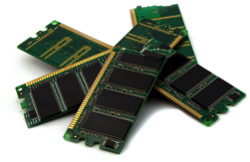
Memory Opt. Dataflow
Map
Reduce
Cached
Load
Training Data
(HDFS)
Map
Reduce
Map
Reduce
10-100× faster than network and disk

Slide 51
Memory Opt. Dataflow View
Map
Reduce
Efficiently move data
between stages
Training Data
(HDFS)
Map
Reduce
Map
Reduce

Slide 52
In-Memory Data-Flow Systems
Common Pattern:
Multi-Stage Aggregation
Abstraction: Dataflow Ops. on Immutable datasets
System

Slide 53
What is Spark?
Fault-tolerant distributed dataflow framework
Improves efficiency through:
In-memory computing primitives
Pipelined computation
Improves usability through:
Rich APIs in Scala, Java, Python
Interactive shell
Up to 100× faster
(2-10× on disk)
2-5× less code
Slide provided by M. Zaharia

Slide 54
Spark Programming Abstraction
Write programs in terms of transformations on distributed datasets
Resilient Distributed Datasets (RDDs)
Distributed collections of objects that can stored in memory or on disk
Built via parallel transformations (map, filter, …)
Automatically rebuilt on failure
Slide provided by M. Zaharia

Slide 55

Example: Log Mining
Load error messages from a log into memory, then interactively search for various patterns
Base RDD
Transformed RDD
Cache 1
lines = spark.textFile(“hdfs://log”)
errors = lines.filter(x => x.startsWith(“ERROR”))
msgs = errors.map(x => x.split(‘\t’)(2)) .cache()
Worker
results
tasks
Block 1
Driver
Action
msgs.filter(x => x.contains(“foo”)).count
msgs.filter(x => x.contains(“bar”)).count
Cache 2
Worker
Cache 3
Result: scaled to 1 TB data in 5-7 sec (vs 170 sec for on-disk data)
Result: full-text search of Wikipedia in <1 sec (vs 20 sec for on-disk data)
Worker
Block 2
Block 3
Slide provided by M. Zaharia

Slide 56

Fault Tolerance
RDDs track lineage info to rebuild lost data
file.map(lambda rec: (rec.type, 1)) .reduceByKey(lambda x, y: x + y) .filter(lambda (type, count): count > 10)
map
reduce
filter
Input file
Slide provided by M. Zaharia

Slide 57
Fault Tolerance
RDDs track lineage info to rebuild lost data
file.map(lambda rec: (rec.type, 1)) .reduceByKey(lambda x, y: x + y) .filter(lambda (type, count): count > 10)
map
reduce
filter
Input file
Slide provided by M. Zaharia

Slide 58
Abstraction: Dataflow Operators
filter
groupBy
sort
union
join
leftOuterJoin
rightOuterJoin
count
fold
reduceByKey
groupByKey
cogroup
cross
zip
sample
take
first
partitionBy
mapWith
pipe
save
...
map
reduce

Slide 59
Batch Gradient Logistic Regression
Load data in memory once
val data = spark.textFile(“hdfs://data”) .map(readPoint).cache()
var w = Vector.random(D)
for (i <- 1 to ITERATIONS) {
val gradient = data.map(p =>
(1 / (1 + exp(-p.y*(w dot p.x))) - 1) * p.y * p.x
).reduce(_ + _)
w -= gradient
}
println("Final w: " + w)
Initial parameter vector
Repeated Map-Reduce steps for gradient descent
Slide provided by M. Zaharia
Notes:
Key idea: add “variables” to the “functions” in functional programming

Slide 60
Logistic Regression Performance
110 s / iteration
first iteration 80 s
further iterations 1 s
29 GB dataset on 20 EC2 m1.xlarge machines (4 cores each)
Slide provided by M. Zaharia
Notes:
This is for a 29 GB dataset on 20 EC2 m1.xlarge machines (4 cores each)

Slide 61

MLlib +
MLlib: high quality library for ML algorithms
Included in Apache Spark
MLbase: make ML accessible to non-experts
Automatically pick best algorithm
Allow developers to easily add and test new algorithms
E. Sparks, A. Talwalkar, V. Smith, J. Kottalam, X. Pan, J. Gonzalez, Michael Franklin, Michael Jordan, Tim Kraska. MLI: An API for Distributed Machine Learning. ICDM’13
T. Kraska, A. Talwalkar, J. C. Duchi, R. Griffith, M. J. Franklin, and M. I. Jordan. MLbase: A Distributed Machine-learning System. CIDR’13

Slide 62
Mahout Moves to Spark
On 25 April 2014 - Goodbye MapReduce
The Mahout community decided to move its codebase onto modern data processing systems that offer a richer programming model and more efficient execution than Hadoop MapReduce. Mahout will therefore reject new MapReduce algorithm implementations from now on.
We are building our future implementations on top of a DSL for linear algebraic operations which has been developed over the last months. Programs written in this DSL are automatically optimized and executed in parallel on Apache Spark.

Slide 63
Other Related Systems
Microsoft Dryad and Naiad:
http://research.microsoft.com/en-us/projects/dryad/
http://research.microsoft.com/en-us/projects/naiad/
Hyracks: http://hyracks.org
Stratosphere: http://stratosphere.eu
MADlib: http://madlib.net
Hadoop Tez: http://hortonworks.com/hadoop/tez/
See publication lists at each of the sites
Notes:
Hyracks from Michael Carey’s group at UC Irvine
Stratosphere is from Volker Markl’s group at TU Berlin
MADLib: Joseph Hellerstein at UC Berkeley and now owned by Pivotal
Hadoop Tez is being developed at HortonWorks

Slide 64
Outline of the Tutorial
Distributed Aggregation: Map-Reduce
Iterative Machine Learning: Spark
Large Shared Models: Parameter Server
Graphical Computation: GraphLab to GraphX

Slide 65
Big Models and Online Algorithms
Parameter Servers
A. Smola and S. Narayanamurthy. An architecture for parallel topic models. VLDB’10
A. Ahmed, M. Aly, J. Gonzalez, S. Narayanamurthy, and A. J. Smola. Scalable inference in latent variable models. WSDM '12

Slide 66
Small → Big Models
d
d
d
d
Big Model
Sparse
Big Data
Small
Model
Big Data
n
d << n
d ≈ n

Slide 67
Examples
Spam prediction using bi-grams:
Weight vector in (#Words)²
Deep Learning:
Billions of model parameters
Topic Modeling (LDA):
Distribution over words for each topic

Slide 68
Common Pattern Latent Var. Models
Global Variables
Local Variables

Slide 69
Challenge of Big Models
Example (Gradient Descent):
Machine 1
Mapper
Mapper
Model
Model
Mapper
Reducer
Mapper
Reducer
Machine 2
Model
Model
Model
Model
Model
Model
Model
Machine 3
Mapper
Mapper
Model
Model
Broadcast and store a copy of the model each iteration

Slide 70

Challenge of Big Models
Data
Data
Data
Driver
Data
Data
Data

Slide 71
Challenge of Big Models
Sparse Changes
to Model
Data
Data
Data
Driver
Data
Data
Data

Slide 72
Challenge of Big Models
Data
Data
Data
Driver
Data
Data
Data

Slide 73
Online Algorithms
Example: Stochastic Gradient Descent
Sparse updates:
Comp. depends on a small part of model:
Sparse additive model update:
Model
Model
Model
Model
Model
Model

Slide 74
Bulk Synchronous Execution
Compute
Communicate
Compute
Machine 1
Iteration
Waste
Iteration
w
w¹
w
Machine 2
Iteration
Iteration
Waste
w
w²
w
Machine 3
Iteration
Waste
Iteration
w
w³
w
Barrier
Barrier

Slide 75
Asynchronous Execution
Compute
Communicate
Compute
Machine 1
Iteration
Waste
Iteration
Machine 2
Iteration
Iteration
Waste
Machine 3
Iteration
Waste
Iteration
Barrier
Barrier
Enable more frequent coordination on parameter values

Slide 76
Asynchronous Execution
Parameter Server (Logical)
w₁
w₂
w₃
w₄
w₅
w₆
w₇
w₈
w₉
Machine 1
Iteration
Iteration
Iteration
Iteration
Machine 2
Iteration
Iteration
Iteration
Machine 3
Iteration
Iteration
Iteration
Iteration
Iteration

Slide 77
Parameter Server Abstraction
Key-Value API with two basic operations:
get(key) → value
add(key, delta)
Model
Model
Model
Notes:
Emphasize serial algorithm design pattern and delayed updates.

Slide 78
Split Model Across Machines
Parameter Server
Parameter Server (Logical)
Parameter Server
Parameter Server
w₁
w₁
w₂
w₂
w₃
w₃
w₄
w₄
w₅
w₅
w₆
w₆
w₇
w₇
w₈
w₈
w₉
w₉
Machine 1
Iteration
Iteration
Iteration
Iteration
Machine 2
Iteration
Iteration
Iteration
Machine 3
Iteration
Iteration
Iteration
Iteration
Iteration

Slide 79
Split Model Across Machines
Parameter Server
Parameter Server
Parameter Server
w₁
w₁
w₂
w₂
w₃
w₃
w₄
w₄
w₅
w₅
w₆
w₆
w₇
w₇
w₈
w₈
w₉
w₉
w₄
w₆
w₃
w₅
w₈
w₉
w₁
w₇
w₂
Data
Data
Data
Data
Split Data Across Machines

Slide 80
Example: Topic Modeling with LDA
Word Dist. by Topic
Local Variables Documents
Tokens
Maintained by the Parameter Server
Maintained by the Workers Nodes

Slide 81
Gibbs Sampling for LDA
Title: Oh, The Places You’ll Go!
You have brains in your head.
You have feet in your shoes.
You can steer yourself any direction you choose.

Slide 82
Gibbs Sampling for LDA
Dictionary
Title: Oh, The Places You’ll Go!
Brains:
Choose:
Direction:
Feet:
Head:
Shoes:
Steer:
Document Model θ_{d}
Document Model θ_{d}
You have brains in your head.
You have feet in your shoes.
You can steer yourself any direction you choose.
z₁
z₂
z₃
z₄
z₅
z₆
z₇

Slide 83
Ex: Collapsed Gibbs Sampler for LDA
Partitioning the model and data
Parameter Server
Parameter Server
Parameter Server
W_{1:10K}
W_{10k:20K}
W_{20k:30K}

Slide 84
Ex: Collapsed Gibbs Sampler for LDA
Get model parameters and compute update
Parameter Server
Parameter Server
Parameter Server
W_{1:10K}
W_{10k:20K}
W_{20k:30K}
Car
Cat
Tire
Mouse
get(“cat”)
get(“tire”)
get(“mouse”)
get(“car”)

Slide 85
Ex: Collapsed Gibbs Sampler for LDA
Send changes back to the parameter server
Parameter Server
Parameter Server
Parameter Server
W_{1:10K}
W_{10k:20K}
W_{20k:30K}
add(“cat”, δ)
add(“tire”, δ)
add(“mouse”, δ)
add(“car”, δ)
δ
δ
δ
δ

Slide 86
Ex: Collapsed Gibbs Sampler for LDA
Adding a caching layer to collect updates
Parameter Server
Parameter Server
Parameter Server
W_{1:10K}
W_{10k:20K}
W_{20k:30K}
Parameter Cache
Parameter Cache
Parameter Cache
Parameter Cache
Car
Dog
Bat
Pig
Cat
Gas
VW
Zoo
Car
Rim
$$
bmw
Mac
iOS
Cat
iPod

Slide 87
Ex: Collapsed Gibbs Sampler for LDA
Inconsistent model replicas
Parameter Server
Parameter Server
Parameter Server
W_{1:10K}
W_{10k:20K}
W_{20k:30K}
Inconsistent Values
Parameter Cache
Parameter Cache
Parameter Cache
Parameter Cache
Car
Dog
Bat
Pig
Cat
Cat
Gas
VW
Zoo
Car
Rim
$$
bmw
Mac
iOS
Cat
Cat
iPod
“Model Replicas” [Dean et al., “Large Scale Distributed Deep Networks” NIPS’12]

Slide 88
Bounding Staleness
Ho et al. “More Effective Distributed ML via a Stale Synchronous Parallel Parameter Server.” NIPS’13
Slow-down fast workers
Force periodic cache synchronization
Fast
Machine 1
Tick
Tick
Tick
Tick
Staleness of 3
Barrier
Slow
Machine 2
Tick
Machine 3
Tick
Tick
Tick

Slide 89
Bounding Staleness
Ho et al. “More Effective Distributed ML via a Stale Synchronous Parallel Parameter Server.” NIPS’13
Slow-down fast workers
Force periodic cache synchronization
Currently the analysis only:
applies to convex functions
characterizes the average objective value
Opportunity for more research.

Slide 90
Fault Tolerance
M. Li et al. Parameter Server for Distributed Machine Learning, Big Learning Workshop, NIPS’13
Consistent Hashing:
Backup
Machine 1
Machine 3
Backup
get(“cat”)
Backup
Machine 2
Key-Space

Slide 91
Parameter Server Implementations
ParameterServer.org: Alex Smola’s Lab
C++, Apache License
Code: https://github.com/mli/parameter_server
Petuum.org: Eric Xing’s Lab
C++, BSD License
Code: https://github.com/sailinglab/petuum

Slide 92
Applications of Parameter Servers
Distributed Gibbs Sampling: A. Ahmed et al., Scalable inference in latent variable models. WSDM '12
Deep Learning: Dean et al., Large Scale Distributed Deep Networks. NIPS’12
Matrix Factorization: Ho et al. More Effective Distributed ML via a Stale Synchronous Parallel Parameter Server. NIPS’13
Stochastic Gradient Descent

Slide 93
Specialization for SGD
Vowpal Wabbit: http://hunch.net/~vw/
Primary use is fast online linear optimization
Distributed optimization tools
Bismark: X. Feng, A. Kumar, B. Recht, and C. Ré. Towards a unified architecture for in-RDBMS analytics. SIGMOD’12
In database incremental gradient descent

Slide 94
Limitations of the Parameter Server
Does not address the data/worker management:
Data-partitioning, recovery, stragglers
Opportunity: Dataflow Integration (e.g., Spark)
Asynchronous model is complicated to debug
Does not capture static dependency structure between data and parameters

Slide 95
Static Data Dependencies
Words
Apple
Cat
Dog
The
Documents

Slide 96
Outline of the Tutorial
Distributed Aggregation: Map-Reduce
Iterative Machine Learning: Spark
Large Shared Models: Parameter Server
Graphical Computation: GraphLab to GraphX

Slide 97

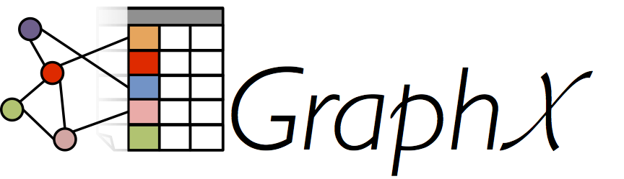
Graph-Structured Big Models
R. Xin, J. Gonzalez, M. Franklin, I. Stoica., GraphX: A Resilient Distributed Graph System on Spark. SIGMOD GRADES’13
J. Gonzalez, Y. Low, H. Gu, D. Bickson, C. Guestrin. PowerGraph: Distributed Graph-Parallel Computation on Natural Graphs. OSDI’12

Slide 98
Graphs are Central to Analytics
Hyperlinks
PageRank
Top 20 Pages
Raw
Wikipedia
Text
Table
Title
PR
< / >
Title
Body
Term-Doc
Graph
Topic Model
(LDA)
< / >
< / >
Word Topics
XML
Word
Topic
Discussion
Table
Community
Detection
User
Community
Community
Topic
Editor Graph
User
Disc.
User
Com.
Topic
Com.

Slide 99
PageRank: Identifying Leaders
Rank of user i
Weighted sum of neighbors’ ranks
Update ranks in parallel
Iterate until convergence

Slide 100

Mean Field Algorithm
X₃
X₂
Y₃
Post
Sum over Neighbors
X₁
Post
Y₂
Y₁
Post

Slide 101
Recommending Products
Low-Rank Matrix Factorization:
f(3)
r₁₃
Movies
f(1)
Netflix
≈
x
Users
Users
f(j)
r₁₄
f(4)
f(i)
User Factors (U)
Movie Factors (M)
r₂₄
f(2)
Movies
r₂₅
f(5)
Iterate:

Slide 102
The Graph-Parallel Pattern
Model / Alg.
State
Computation depends only on the neighbors

Slide 103
Many Graph-Parallel Algorithms
MACHINE LEARNING
SOCIAL NETWORK ANALYSIS
Collaborative Filtering
Alternating Least Squares
Stochastic Gradient Descent
Tensor Factorization
Structured Prediction
Loopy Belief Propagation
Max-Product Linear Programs
Gibbs Sampling
Semi-supervised ML
Graph SSL
CoEM
Community Detection
Triangle-Counting
K-core Decomposition
K-Truss
Graph Analytics
PageRank
Personalized PageRank
Shortest Path
Graph Coloring
Classification
Neural Networks
GRAPH ALGORITHMS

Slide 104

Graph-Parallel Systems
Pregel
Expose specialized APIs to simplify graph programming.

Slide 105
“Think like a Vertex.”
- Pregel [SIGMOD’10]

Slide 106
The Pregel (Push) Abstraction
Vertex-Programs interact by sending messages.
Pregel_PageRank(i, messages) :
// Receive all the messages
total = 0
foreach( msg in messages) :
total = total + msg
// Update the rank of this vertex
R[i] = 0.15 + total
// Send new messages to neighbors
foreach(j in out_neighbors[i]) :
Send msg(R[i]) to vertex j
i
Malewicz et al. [PODC’09, SIGMOD’10]

Slide 107
The GraphLab (Pull) Abstraction
Vertex Programs directly access adjacent vertices and edges
GraphLab_PageRank(i)
// Compute sum over neighbors
total = 0
foreach( j in neighbors(i)):
total = total + R[j] * w_{ji}
// Update the PageRank
R[i] = 0.15 + total
R[4] * w₄₁
4
+
1
R[3] * w₃₁
R[2] * w₂₁
+
3
2
Data movement is managed by the system and not the user.

Slide 108
Iterative Bulk Synchronous Execution
Compute
Communicate
Barrier

Slide 109
Graph-Parallel Systems
Pregel
Exploit graph structure to achieve orders-of-magnitude performance gains over more general data-parallel systems.

Slide 110
Shrinking Working Sets
PageRank on Web Graph
51% of vertices run only once!

Slide 111
The GraphLab (Pull) Abstraction
Vertex Programs directly access adjacent vertices and edges
GraphLab_PageRank(i)
// Compute sum over neighbors
total = 0
foreach( j in neighbors(i)):
total = total + R[j] * w_{ji}
// Update the PageRank
R[i] = 0.15 + total
R[4] * w₄₁
GraphLab_PageRank(i)
// Compute sum over neighbors
total = 0
foreach( j in neighbors(i)):
total = total + R[j] * w_{ji}
// Update the PageRank
R[i] = 0.15 + total
// Trigger neighbors to run again
if R[i] not converged then
signal nbrsOf(i) to be recomputed
4
+
1
R[3] * w₃₁
R[2] * w₂₁
+
3
2
Trigger computation only when necessary.

Slide 112

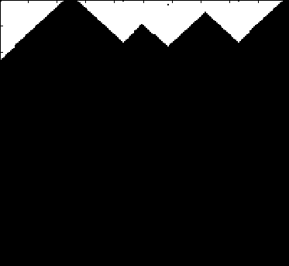
Shrinking Working Sets in Graphical Model Inference
Many
Updates
Splash
Synthetic Noisy Image
Few
Updates
Vertex Updates
Algorithm identifies and focuses
on hidden sequential structure
Factor Graph

Slide 113
Real-World Graphs
Edges >> Vertices
Power-Law Degree Distribution
AltaVista WebGraph1.4B Vertices, 6.6B Edges
More than 10⁸ vertices have one neighbor.
Top 1% of vertices are adjacent to
50% of the edges!
-Slope = α ≈ 2
Number of Vertices
Degree

Slide 114
Challenges of High-Degree Vertices
Sequentially process edges
Touches a large
fraction of graph
CPU 1
CPU 2
Provably Difficult to Partition
Notes:
Power-Law graphs do not have low-cost balanced cuts [Leskovec et al. 08, Lang 04]
Traditional graph-partitioning algorithms perform poorly on Power-Law Graphs. [Abou-Rjeili et al. 06]

Slide 115
GraphLab
(PowerGraph, OSDI’12)
Program This
Run on This
Machine 1
Machine 2
Split High-Degree vertices
New Abstraction → Equivalence on Split Vertices

Slide 116
GAS Decomposition
Machine 1
Machine 2
Master
Gather
Y’
Y’
Y’
Y’
Σ₁
Σ
Σ₂
+ + +
Mirror
Apply
Y
Y
Y
Y
Machine 3
Machine 4
Scatter
Σ₃
Σ₄
Mirror
Mirror

Slide 117
Minimizing Communication in PowerGraph
Vertex Cut
Communication is linear in the number of machines each vertex spans.
Y
Y
Y
Total communication upper bound:

Slide 118
2D Partitioning
v_{i}
Vertices
1
2
2
3
4
Adj.
Matrix
16 Machines
v_{i}
5
6
7
8
5
6
7
8
v_{i} only has neighbors on
7 machines
Vertices
9
10
10
11
12
13
14
14
15
16

Slide 119
PageRank on the Live-Journal Graph
Spark is 4x faster than Hadoop
GraphLab is 16x faster than Spark
Notes:
Live Journal 5.4 Million V and 79 Million E

Slide 120
Triangle Counting on Twitter
40M Users, 1.4 Billion Links
Counted: 34.8 Billion Triangles
Hadoop [WWW’11]
1536 Machines
423 Minutes
64 Machines
15 Seconds
1000 x Faster
GraphLab
S. Suri and S. Vassilvitskii, “Counting triangles and the curse of the last reducer,” WWW’11

Slide 121
Graph Analytics Pipeline
Hyperlinks
PageRank
Top 20 Pages
Raw
Wikipedia
Text
Table
Title
PR
< / >
Title
Body
Term-Doc
Graph
Topic Model
(LDA)
< / >
< / >
Word Topics
XML
Word
Topic
Discussion
Table
Community
Detection
User
Community
Community
Topic
Editor Graph
User
Disc.
User
Com.
Topic
Com.

Slide 122
Tables
Hyperlinks
PageRank
Top 20 Pages
Raw
Wikipedia
Text
Table
Title
PR
< / >
Title
Body
Term-Doc
Graph
Topic Model
(LDA)
< / >
< / >
Word Topics
XML
Word
Topic
Discussion
Table
Community
Detection
User
Community
Community
Topic
Editor Graph
User
Disc.
User
Com.
Topic
Com.

Slide 123
Graphs
Hyperlinks
PageRank
Top 20 Pages
Raw
Wikipedia
Text
Table
Title
PR
< / >
Title
Body
Term-Doc
Graph
Topic Model
(LDA)
< / >
< / >
Word Topics
XML
Word
Topic
Discussion
Table
Community
Detection
User
Community
Community
Topic
Editor Graph
User
Disc.
User
Com.
Topic
Com.

Slide 124



Separate Systems to Support Each View
Table View
Graph View
Pregel
Table
Dependency Graph
Row
Row
Result
Row
Row

Slide 125
Having separate systems for each view is difficult to use and inefficient

Slide 126



Difficult to Program and Use
Users must Learn, Deploy, and Manage multiple systems
Leads to brittle and often complex interfaces

Slide 127


Inefficient
Extensive data movement and duplication across the network and file system
< / >
< / >
< / >
XML
HDFS
HDFS
HDFS
HDFS
Limited reuse internal data-structures across stages

Slide 128
GraphX Solution: Tables and Graphs are views of the same physical data
GraphX Unified
Representation
Table View
Graph View
Each view has its own operators that exploit the semantics of the view
to achieve efficient execution

Slide 129
Graphs → Dataflow
Encode graphs as distributed tables (RDDs)
Express graph computation in relational ops.
Recast graph systems optimizations as:
Distributed join optimization
Incremental materialized maintenance
Integrate Graph and Table data processing systems.
Achieve performance parity with specialized systems.

Slide 130
Distributed Graphs as Distributed Tables
Vertex Table
Routing
Table
Edge Table
Property Graph
Part. 1
A
B
B
A
A
1
2
B
C
C
A
C
B
B
1
B
C
C
D
A
A
A
D
D
D
C
C
1
2D Vertex Cut Heuristic
A
D
Part. 2
A
E
D
D
1
2
A
F
F
F
E
E
E
E
2
E
D
F
F
2
E
F

Slide 131
Spark Dataflow Operators
Inherited from Spark:
map
filter
groupBy
sort
union
join
leftOuterJoin
rightOuterJoin
reduce
count
fold
reduceByKey
groupByKey
cogroup
cross
zip
sample
take
first
partitionBy
mapWith
pipe
save
...

Slide 132
Graph Operators
class Graph [ V, E ] {
def Graph(vertices: Table[ (Id, V) ],
edges: Table[ (Id, Id, E) ])
// Table Views -----------------
def vertices: Table[ (Id, V) ]
def edges: Table[ (Id, Id, E) ]
def triplets: Table [ ((Id, V), (Id, V), E) ]
// Transformations ------------------------------
def reverse: Graph[V, E]
def subgraph(pV: (Id, V) => Boolean,
pE: Edge[V,E] => Boolean): Graph[V,E]
def mapV(m: (Id, V) => T ): Graph[T,E]
def mapE(m: Edge[V,E] => T ): Graph[V,T]
// Joins ----------------------------------------
def joinV(tbl: Table [(Id, T)]): Graph[(V, T), E ]
def joinE(tbl: Table [(Id, Id, T)]): Graph[V, (E, T)]
// Computation ----------------------------------
def mrTriplets(mapF: (Edge[V,E]) => List[(Id, T)], reduceF: (T, T) => T): Graph[T, E]
}

Slide 133
Triplets Join Vertices and Edges
The triplets operator joins vertices and edges:
SELECT s.Id, d.Id, s.P, e.P, d.P
FROM edges AS e
JOIN vertices AS s, vertices AS d
ON e.srcId = s.Id AND e.dstId = d.Id
Vertices
Triplets
Edges
A
A
A
A
B
B
B
B
A
C
A
C
C
B
C
B
C
D
C
D
C
D
The mrTriplets operator sums adjacent triplets.
SELECT t.dstId, reduce( map(t) ) AS sum
FROM triplets AS t GROUPBY t.dstId
Notes:
w

Slide 134
Example: Oldest Follower
23
42
B
C
Calculate the number of older followers for each user?
val olderFollowerAge = graph .mrTriplets( e => // Map if(e.src.age < e.dst.age) { (e.srcId, 1) else { Empty } , (a,b) => a + b // Reduce ) .vertices
30
A
D
19
E
75
F
16

Slide 135
Caching for Iterative mrTriplets
Vertex Table (RDD)
Edge Table
(RDD)
Mirror
Cache
A
B
A
A
A
A
A
C
B
B
B
B
C
C
D
C
D
C
C
Mirror
Cache
A
E
D
D
D
A
A
F
E
D
E
E
D
E
F
F
F
E
F

Slide 136
Incremental Updates for Iterative mrTriplets
Vertex Table (RDD)
Edge Table
(RDD)
Mirror
Cache
A
B
Change
A
A
A
A
A
C
B
B
B
C
C
D
C
D
C
Mirror
Cache
A
E
D
A
A
F
D
Change
E
Scan
E
E
D
E
F
F
E
F

Slide 137
Aggregation for Iterative mrTriplets
Vertex Table (RDD)
Edge Table
(RDD)
Mirror
Cache
A
B
Change
A
A
A
C
Local
Aggregate
B
B
Change
B
B
C
C
C
D
C
D
Change
C
Mirror
Cache
A
E
Change
D
A
A
F
Local
Aggregate
D
E
Scan
Change
D
E
D
E
Change
F
F
F
E
F

Slide 138
PageRank in GraphX
// Load and initialize the graph
val graph = GraphBuilder.text(“hdfs://web.txt”)
val prGraph = graph.joinVertices(graph.outDegrees)
// Implement and Run PageRank
val pageRank =
prGraph.pregel(initialMessage = 0.0, iter = 10)(
(oldV, msgSum) => 0.15 + 0.85 * msgSum,
triplet => triplet.src.pr / triplet.src.deg,
(msgA, msgB) => msgA + msgB)

Slide 139
Example Analytics Pipeline
// Load raw data tables
val verts = sc.textFile(“hdfs://users.txt”).map(parserV)
val edges = sc.textFile(“hdfs://follow.txt”).map(parserE)
// Build the graph from tables and restrict to recent links
val graph = new Graph(verts, edges)
val recent = graph.subgraph(edge => edge.date > LAST_MONTH)
// Run PageRank Algorithm
val pr = graph.PageRank(tol = 1.0e-5)
// Extract and print the top 25 users
val topUsers = verts.join(pr).top(25).collect
topUsers.foreach(u => println(u.name + ‘\t’ + u.pr))

Slide 140
GraphX scales to larger graphs
Twitter Graph: 1.5 Billion Edges
GraphX is roughly 2x slower than GraphLab
Scala + Java overhead: Lambdas, GC time, …
No shared memory parallelism: 2x increase in comm.
Notes:
41 Million Vertices

Slide 141
PageRank is just one stage…. What about a pipeline?

Slide 142
A Small Pipeline in GraphX
Raw Wikipedia
Hyperlinks
PageRank
Top 20 Pages
< / >
< / >
< / >
HDFS
HDFS
XML
Spark Preprocess
Compute
Spark Post.
605
375
Timed end-to-end GraphX is faster than GraphLab
Notes:
Also faster in human time but it is hard to measure.

Slide 143
GraphX: Unified Graph Analytics
New API
Blurs the distinction between Tables and Graphs
New System
Combines Data-Parallel Graph-Parallel Systems
Enabling users to easily and efficiently express the entire graph analytics pipeline

Slide 144
Current Limitations of GraphX
No support for asynchronous computation
Favor determinism over speed
Not optimized for out-of-core processing
GraphLab Create (GraphLab + GraphX):
Supports asynchrony and out-of-core processing
Currently not distributed

Slide 145
Outline of the Tutorial
Distributed Aggregation: Map-Reduce
Iterative Machine Learning: Spark
Large Shared Models: Parameter Server
Graphical Computation: GraphLab to GraphX
Data Parallel
Model Parallel
Graph Parallel

Slide 146
Outline of the Tutorial
Data Parallel
GraphX & GraphLab Create
Graph Parallel
Model Parallel

Slide 147
Future Directions

Slide 148
Themes in Learning Systems
Optimize for common patterns: aggregation, iteration, large-models, and graphs
Others?
Leverage hardware trends: in-memory comp and elastic compute on commodity hardware
RDMA, SSDs?
Tradeoff accuracy and runtime with sampling and asynchrony

Slide 149


Research Opportunities
Concurrent State Mngmt.
Database
Systems
Research
Machine
Learning
Research
Sampling and Approx. Query Processing
Query Optimization

Slide 150
Concurrency Control
Coordination Free (Parameter Server):
Provably fast and correct under key assumptions.
Optimistic Concurrency Control:
Provably correct and fast under key assumptions.
Database Systems
Improve Efficiency
X. Pan, J. Gonzalez, S. Jegelka, T. Broderick, M. Jordan. Optimistic Concurrency Control for Distributed Unsupervised Learning. NIPS’13

Slide 151
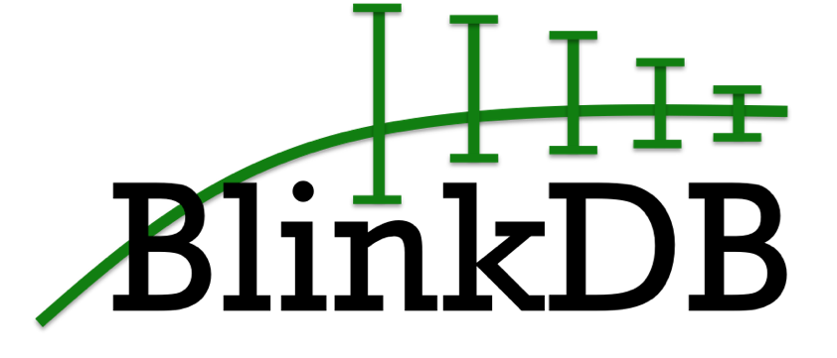
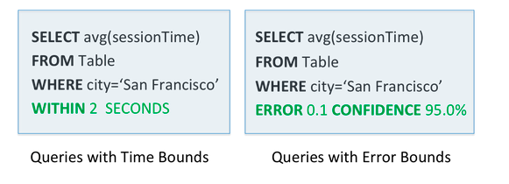
Exploit sampling for fast, approximate answers with error bars:
Can we do the same for learning?
Agarwal et al., BlinkDB: Queries with Bounded Errors and Bounded Response Times on Very Large Data. ACM EuroSys 2013,

Slide 152
Insight: A Declarative Approach to ML
SQL
Result
MLQL
Model
T. Kraska, A. Talwalkar, J. C. Duchi, R. Griffith, M. J. Franklin, and M. I. Jordan. MLbase: A Distributed Machine-learning System. CIDR’13

Slide 153
Systems
Research
Machine Learning
Research
Research
Opportunity

Slide 154
Thank You Questions?
Joseph E. Gonzalez
jegonzal@eecs.berkeley.edu
Slides (with animations) available at
http://eecs.berkeley.edu/~jegonzal

Slide 155
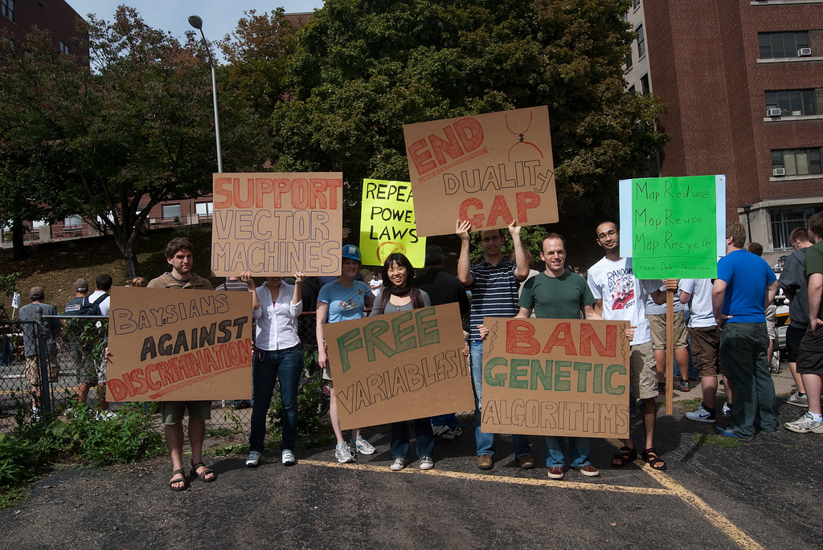

Slide 156
How Systems Researchers Build Systems
Define the Problem
Identify constraints and abstract the problem
Propose Solution: Simple Idea
Don’t try to solve everything
Implement the System
Reuse existing systems wherever possible
Evaluation
Support the design decisions
What are the tradeoffs and limitations?

